Slide 1
The care and use of the Room 241 video display and Skype Facility
Never Unplug any cable from the back to these units!!

Slide 2
There are two options for using this set up:
Either using the computer under the monitor or wirelessly with a laptop
Each are covered in this presentation

Slide 3
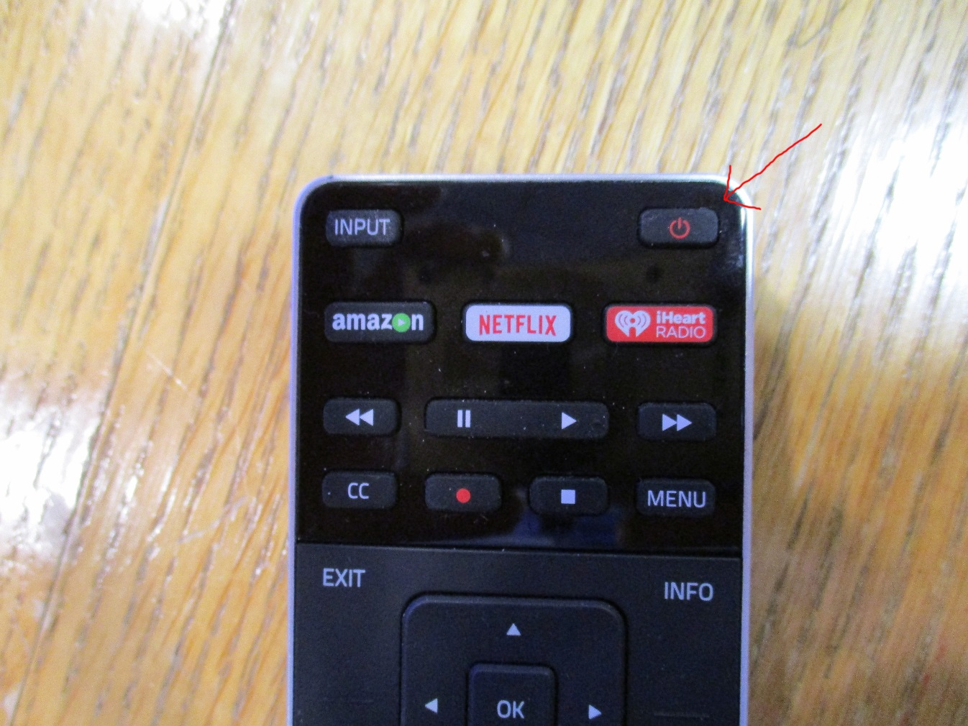
Step one: Turn on the Monitor

Slide 4

Step two Select your input

Slide 5
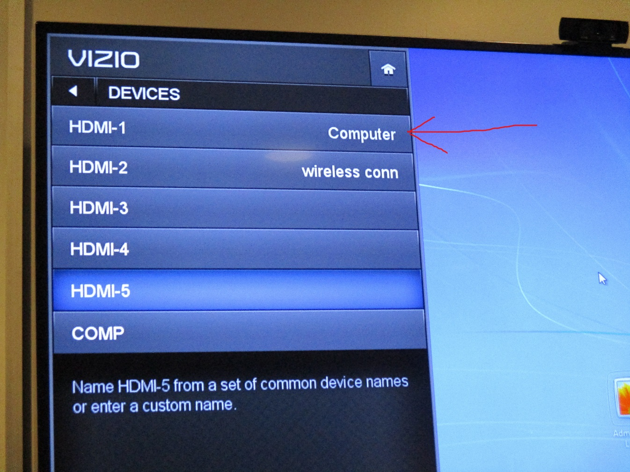
Scroll to Computer, if using files from a thumb drive or Skype

Slide 6
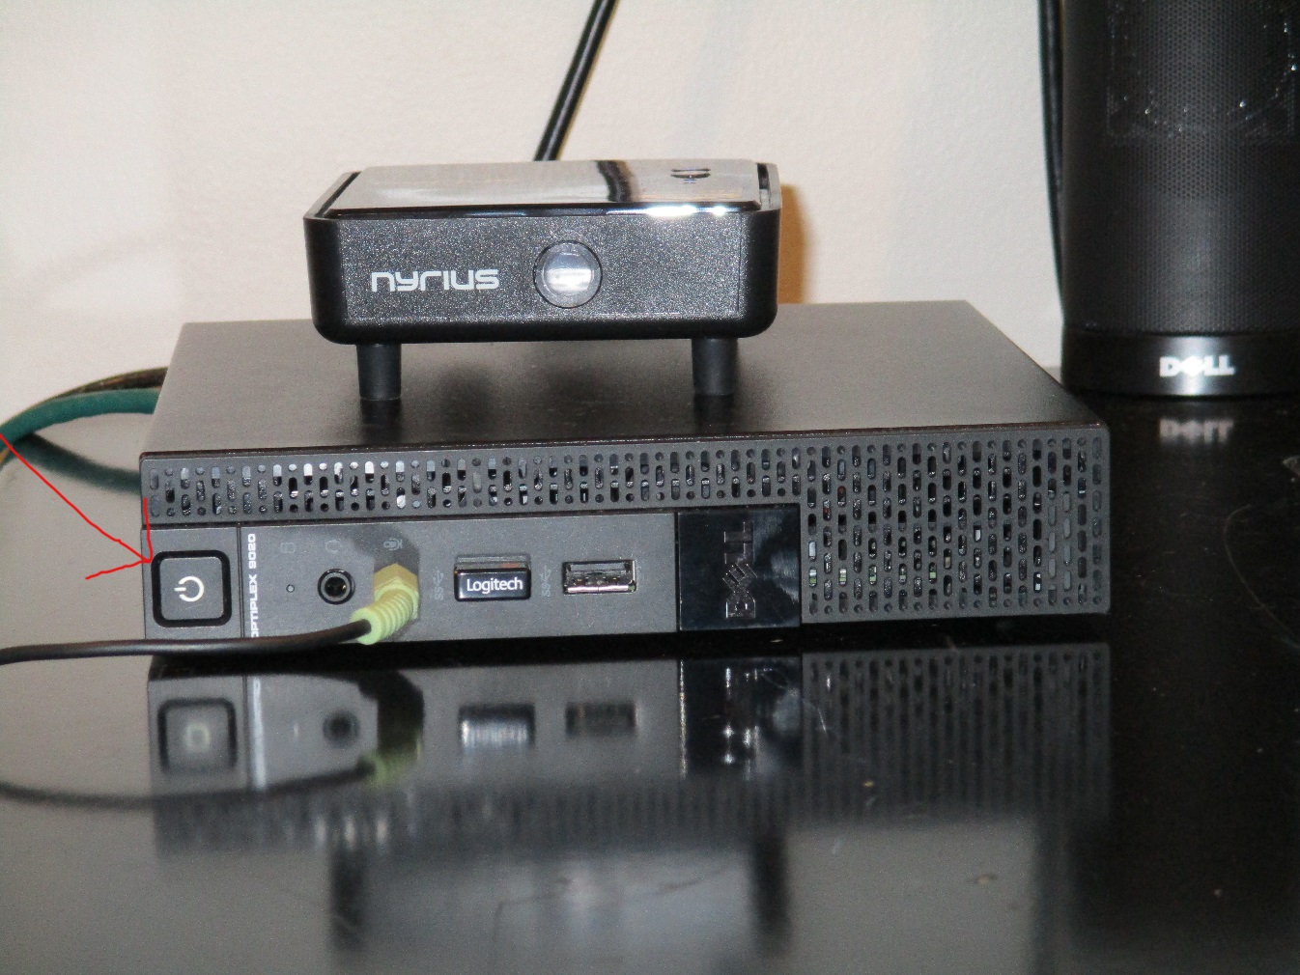
Turn on the Computer, be patient, this will take about a minute to display an image

Slide 7
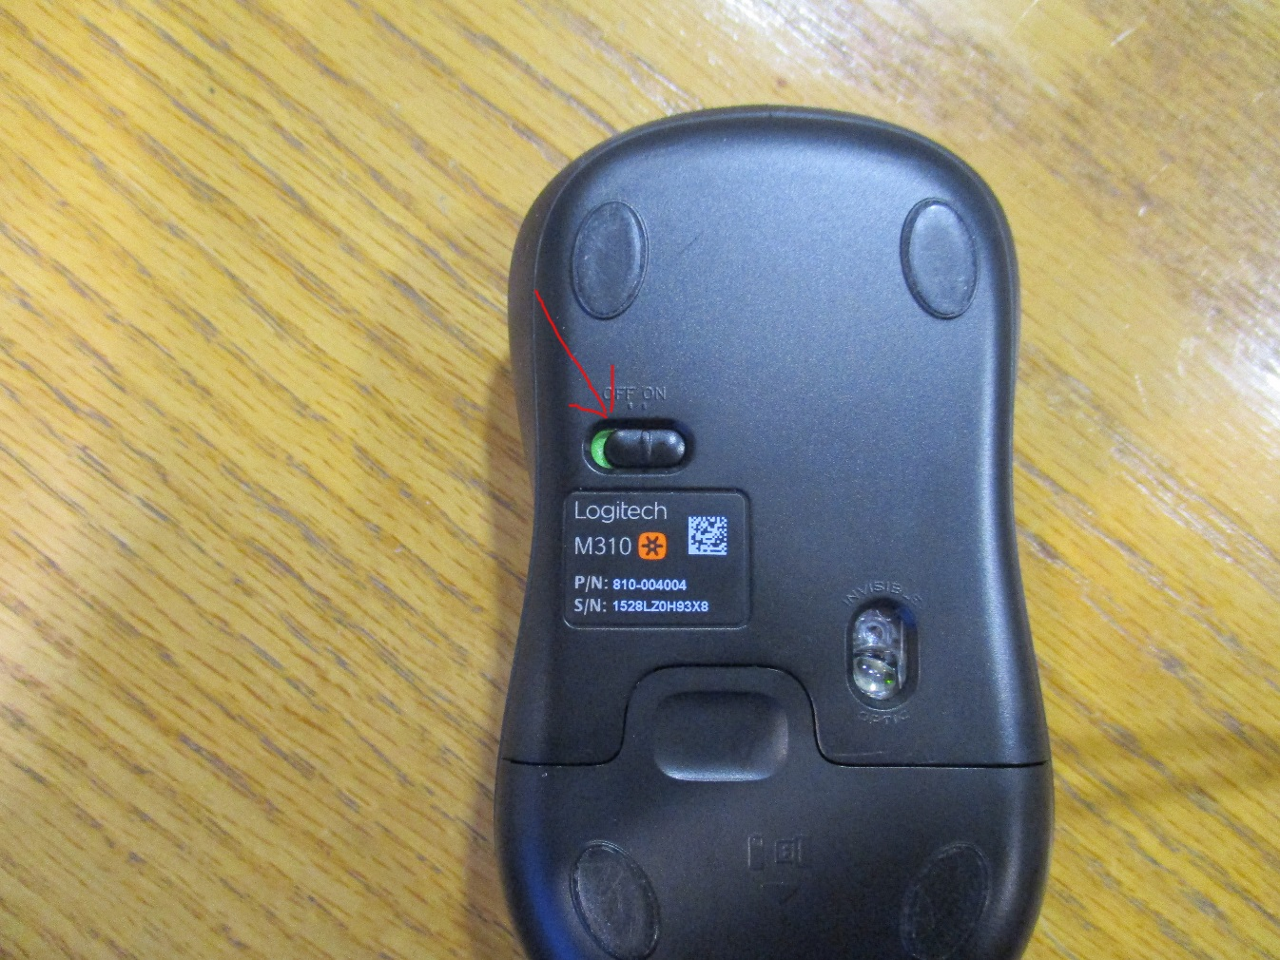
Flip the mouse over and switch it to on

Slide 8
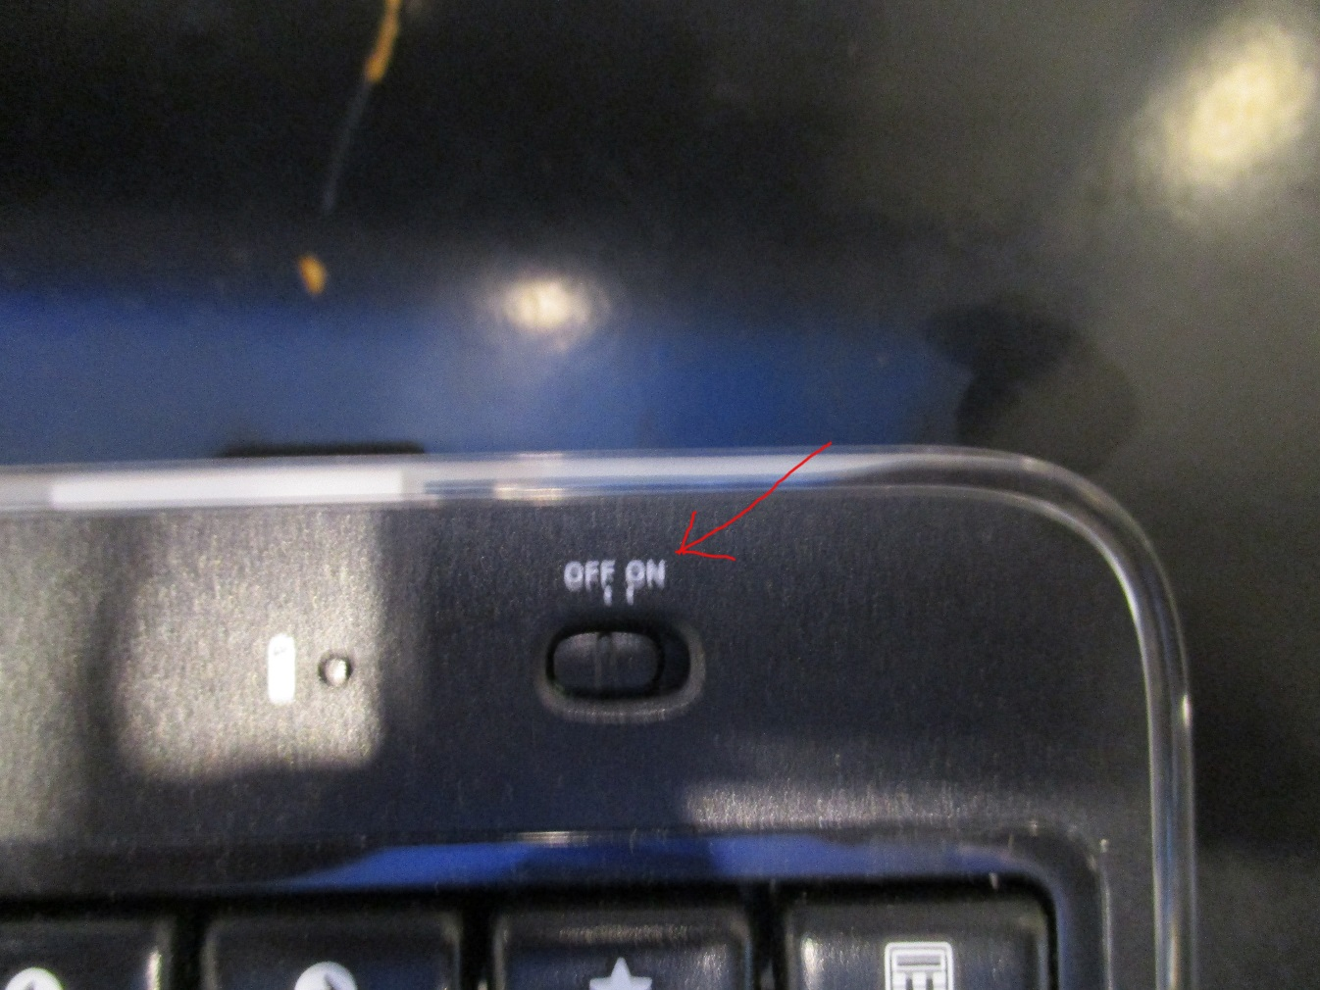
Turn on the keyboard using the switch on the upper right side.

Slide 9
When done with your presentation please:
1)Turn off the computer
2)Turn off the monitor
3) Turn off the lights & lock the door
Never, ever put games on this computer
This room is not meant for entertainment!

Slide 10
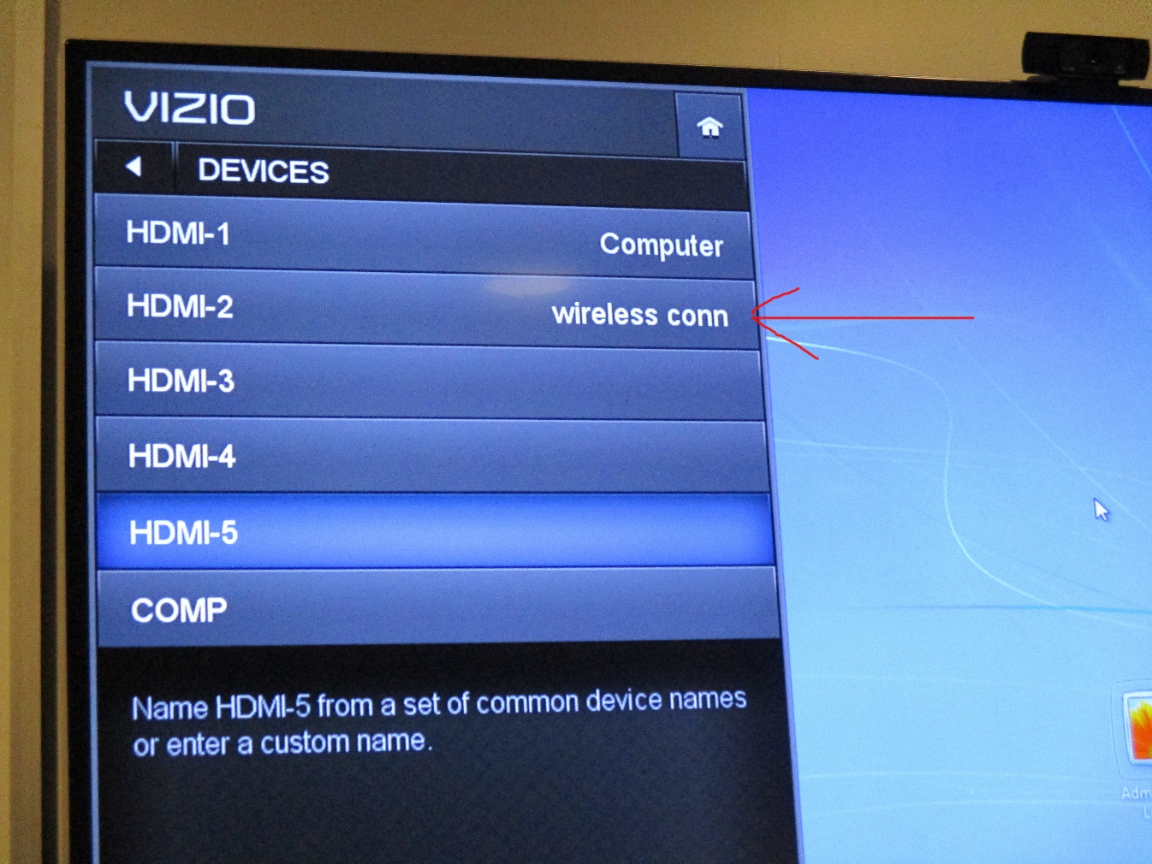
To use a laptop wirelessly, use remote, choose “wireless conn”.

Slide 11
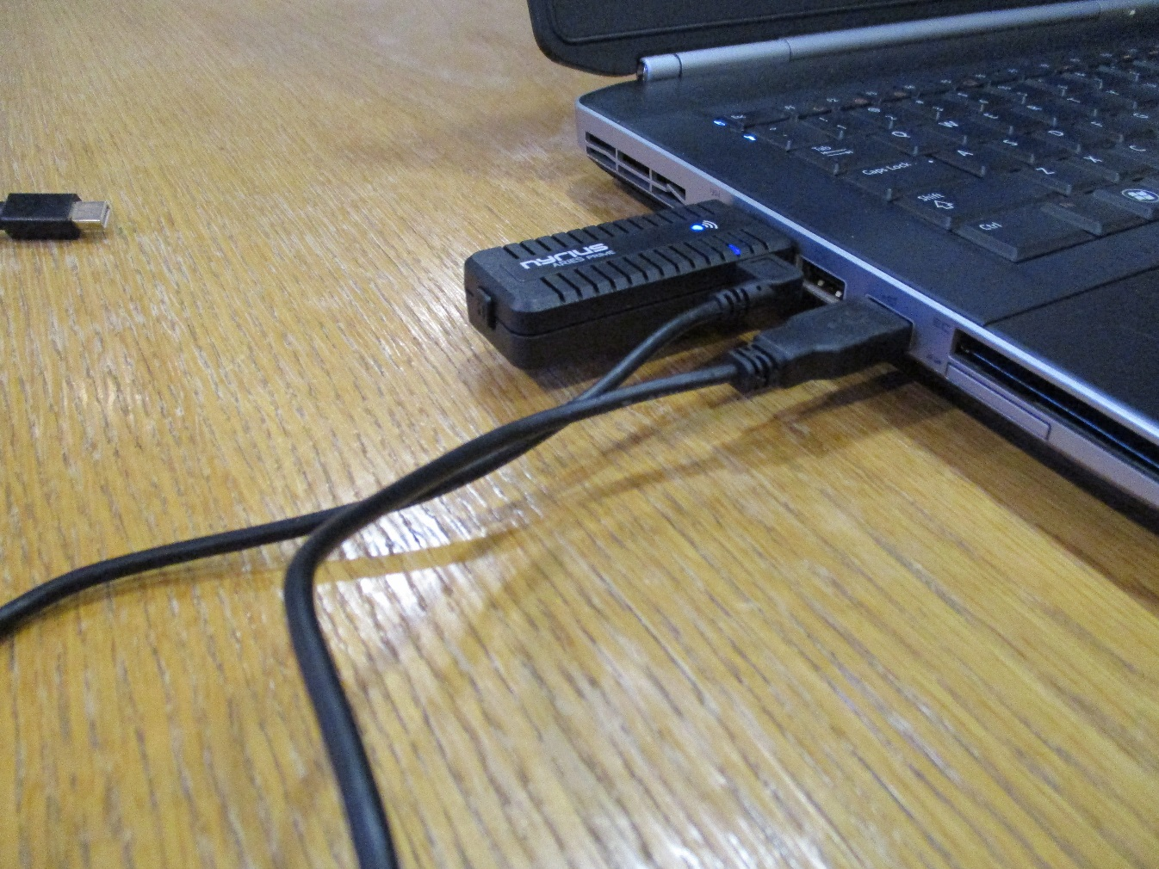
Plug USB into laptop and HDMI into laptop, these are never plugged into the computer under the monitor

Slide 12
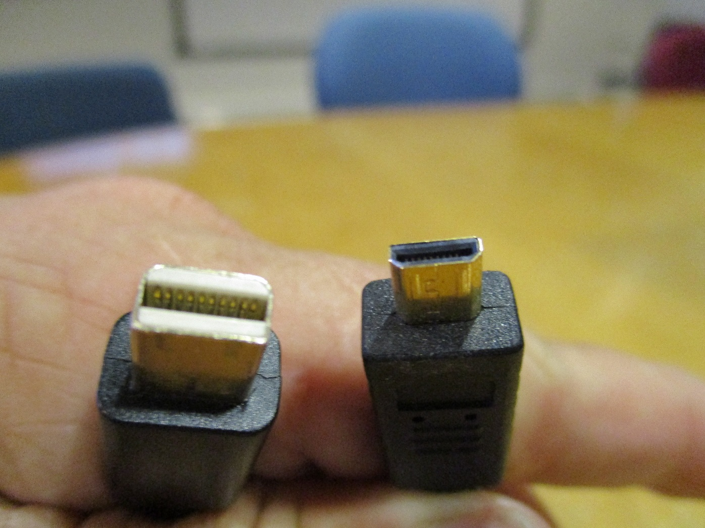
For Laptops without standard HDMI Use these special adapters for micro HDMI or Apple data port

Slide 13
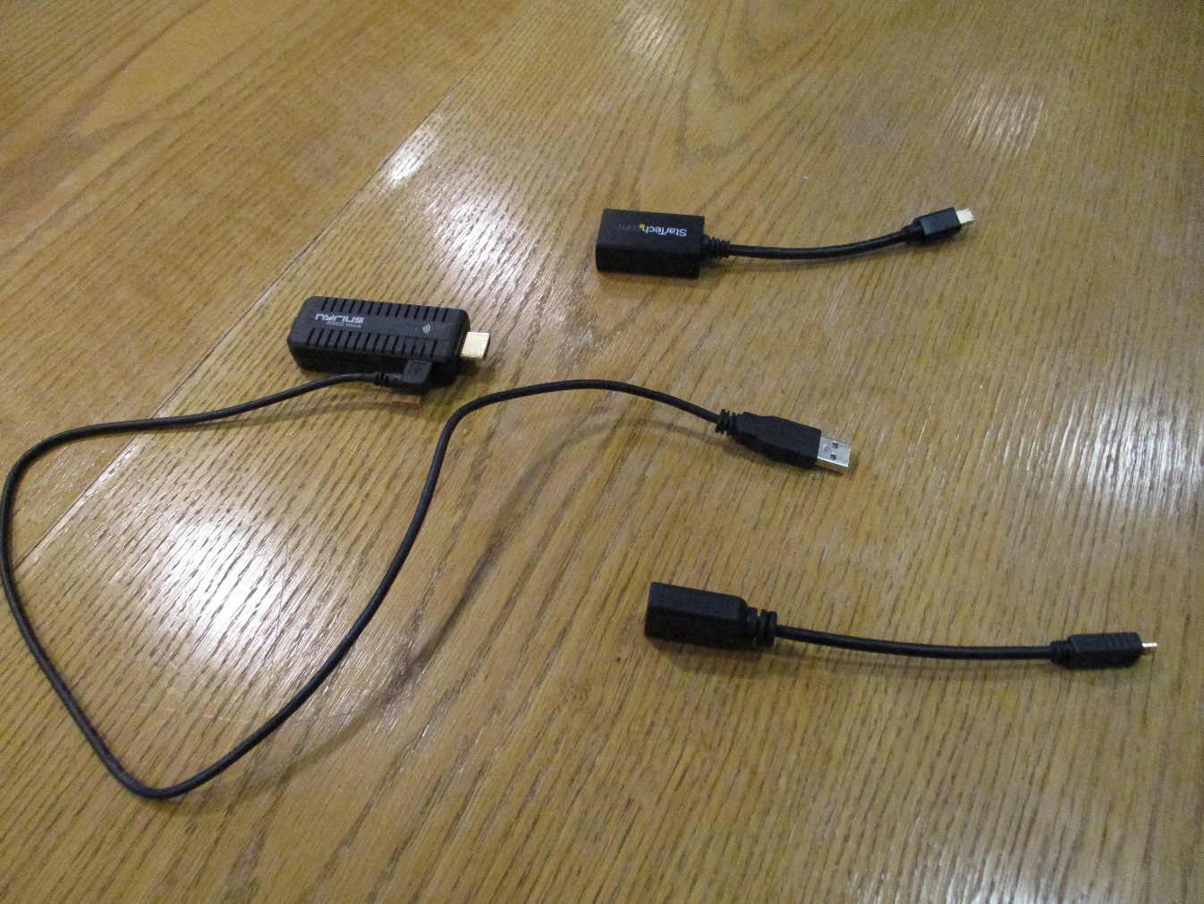
These adapters are with the HDMI adapter usually on the table under the monitor

Slide 14
As your laptop boots, image will display in ~30 secs. Be Patient!
Scrolling needlessly through menus and removing wires from where they are set up never fixes a problem, especially with electronics!

Slide 15
When done with the setup please:
1)Turn off the computer
2)Turn off the monitor
3) Turn off the lights & lock the door
Never, ever put games on this computer
This room is not meant for entertainment!

